Slide 1
South Lewis Up-Date
Sept. 2017
Welcome Back!!

Slide 2
Ela & math cc using modules…
ALL GRADES UPK-12 ELA AND MATH HAVE TRANSITIONED TO THE COMMON CORE MODULES
2013-14
ELA (UPK-9th Grade)
Mathematics (5th – Algebra)
2014-15
ELA (10th Grade)
Mathematics (UPK-4th Grade and Geometry)
2015-16
ELA (11th Grade)
Mathematics (Algebra II)
2016-17
ELA (12th Grade)
Mathematics (Pre-Calculus)

Slide 3
Common core regents…
ALL ELA AND MATH REGENTS ARE NOW THE COMMON CORE VERSIONS
Typical Sequence:
9th grade – Algebra CC
10th grade – Geometry CC
11th grade – Algebra II CC and English CC

Slide 4
Social studies…
NYS SS Framework was adopted about 3 years ago
There are 6 “Inquiries” available from New York State (per grade) that districts may choose to use as part of this implementation, but they will need to also create/purchase lesson plans and additional activities to have a complete curriculum
2016-17 – Each grade level selected a minimum of 2 of the NYS offered “Inquiries” to teach consistently across the grade level (and work on creating the lesson plans and activities to support these inquiries completely)

Slide 5
South lewis plan…
2017-18 – Each grade level will select a minimum of 4 of the NYS offered “Inquiries” to teach consistently across the grade level (and work on creating the lesson plans and activities to support these inquiries completely)
South Lewis has purchased McGraw Hill’s digital textbook for all SS teachers and students in 2017-18
South Lewis has made Brain Honey/Buzz available to all SS teachers for additional ideas

Slide 6
What’s new…
A lot of the content taught is similar to the “old” SS standards
However, the approach to teaching SS is more inquiry based, using primary documents, research, student development of questions and conclusions, thematic/conceptual, etc.

Slide 7
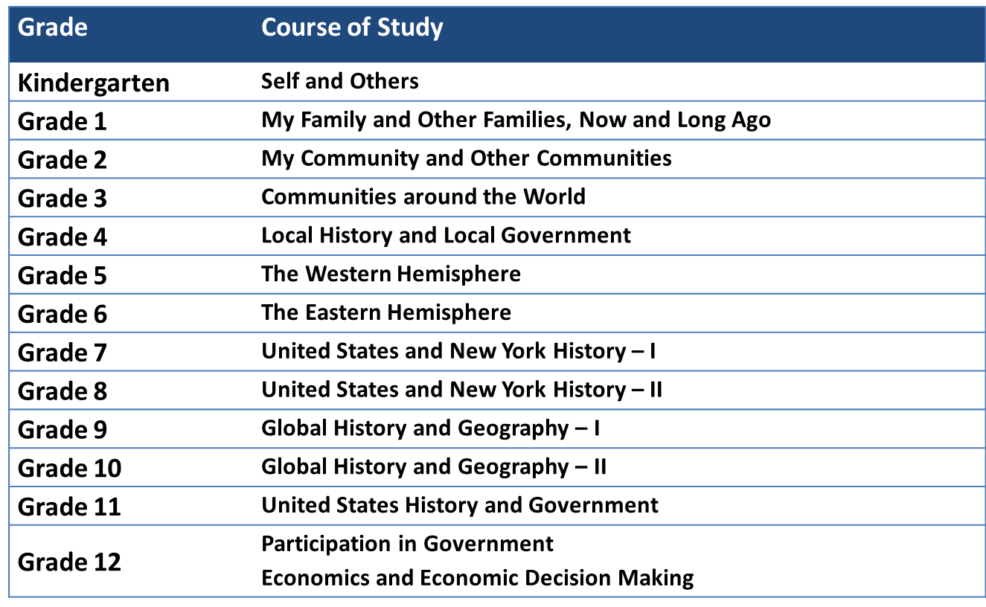
Ss Content covered at each gr…

Slide 8
Science…
New P-12 Science Learning Standards have been adopted (Dec. 2016)
Initial transition to the new standards shall begin in districts this year (2017-18)
Our goal is to begin reviewing the new standards and begin learning about them, but the state will be providing examples/curriculum/resources
Danielle Abrial is our elementary math coach and will also coach and turn-key Science to gr. UPK-4
The state Science assessments will be changing (approximate time-frame is 2021):
The 4th gr. Science test will move to 5th gr.
Earth Science will be called Earth and Space Science
The assessments/Regents will match the new standards

Slide 9
Science…
Just like with ELA/math/SS, it is not just new content to teach
We must change the way we teach:
Hands on experiments
Students engaged and generating hypothesis and drawing conclusions
Students interpreting and inferring
Student collaboration
Students facilitating the construction of knowledge
Students doing research

Slide 10
Fine arts standards…
Draft form – slated for review/approval at the Board of Regents Meeting in Sept. 2017
Will be coming soon

Slide 11
Elementary district Data… percent proficient (level 3 or 4)
TEST | 2012-13 | 2013-14 | 2014-15 | 2015-16 | 2016-17
Science 4 | 91% | 96% | 94% | 96% | 96%
ELA 3 CC | 15% | 23% | 22% | 33% | 35%
ELA 4 CC | 24% | 33% | 27% | 41% | 35%
Math 3 CC | 31% | 40% | 46% | 56% | 44%
Math 4 CC | 31% | 42% | 57% | 48% | 51%

Slide 12
Middle school building Data…
TEST | 2012-13 | 2013-14 | 2014-15 | 2015-16 | 2016-17
Science 8 | 93% | 76% | 71% | 73% | 65%
ELA 5 CC | 19% | 24% | 19% | 27% | 37%
ELA 6 CC | 25% | 29% | 17% | 30% | 36%
ELA 7 CC | 25% | 25% | 26% | 28% | 29%
ELA 8 CC | 19% | 33% | 24% | 29% | 21%
Math 5CC | 25% | 29% | 36% | 34% | 40%
Math 6CC | 24% | 35% | 36% | 34% | 49%
Math 7CC | 12% | 17% | 38% | 35% | 25%
Math 8CC Honors 8 Excluded | 16% | 12% | 9% * | 9% * | 7% *

Slide 13
high school building Data… percent passing (65+)
TEST | 2008-09 | 2009-10 | 2010-11 | 2011-12 | 2012-13 | 2013-14 | 2014-15 | 2015-16
Comprehensive English | 96% | 83% | 95% | 89% | 85% | 92% | 95% | -
CC English |  |  |  |  |  |  |  | 96%
Integrated Algebra | 95% | 88% | 94% | 81% | 88% | 74% | 55% | -
CC Algebra | - | - | - | - | - | 58% | 60% | 71%
Geometry | 100% | 92% | 92% | 95% | 94% | 95% | 81% | -
CC Geometry | - | - | - | - | - | - | 83% | 75%
Algebra2/Trigonometry | - | 72% | 69% | 60% | 63% | 64% | 41% | 50%
CC Alg II |  |  |  |  |  |  |  | 88%
Global History and Geog. | 79% | 74% | 75% | 78% | 77% | 71% | 70% | 84%
U.S. History and Gov. | 96% | 84% | 88% | 85% | 89% | 93% | 89% | 95%
Living Environment | 100% | 93% | 95% | 94% | 91% | 95% | 88% | 92%
Physical Setting/Earth Science | 70% | 72% | 75% | 80% | 71% | 76% | 87% | 62%
Physical Setting/Chemistry | 94% | 100% | 87% | 86% | 86% | 88% | 75% | 84%
Physical Setting/Physics | 100% | 100% | 85% | 81% | 64% | 100% | 91% | 82%

Slide 14
 | 2008-09 (2005 Cohort) | 2009--10 (2006 Cohort) | 2010-11 (2007 Cohort) | 2011-12 (2008 Cohort) | 2012-13 (2009 Cohort) | 2013-14 (2010 Cohort) | 2014-15 (2011 Cohort) | 2015-16 (2012 Cohort)
South Lewis High School | 79% | 86% | 78% | 83% | 86% | 88% | 87% | 88%
4-Year Graduation
Rate
% Who Are 4 Year Graduates & Earned Reg w/ Advanced Designation | 2010-11 (2007 Cohort) | 2011-12 (2008 Cohort) | 2012-13 (2009 Cohort) | 2013-14 (2010 Cohort) | 2014-15 (2011 Cohort) | 2015-16 (2012 Cohort)
South Lewis High School | 39% | 38% | 29% | 36% | 34% | 32%

Slide 15
Growth scores…
We feel that Growth Scores provided by NYS are one of the most accurate measures of whether or not we are moving students.
WHY??
It’s the only measure where the ability and characteristics of our students are taken into consideration.

Slide 16
Growth scores…
Each student is put into a category of students like him/her based on:
-prior state scores
-prior course scores
-identifiers like SWD, ED
-it also takes into account how many children in the
whole course are ED or SWD as the class make- up can impact achievement
-concept is, when put in that group, what percentile rank did that child’s state score fall at (between 1-99)
-a 50 would be right in the middle

Slide 18
High School…
GRE = Growth in Regents Exams Passed
This measure compares how much progress our students are making from one year to the next toward passing up to 8 Regents exams, when compared to students with a similar academic ability and background.
A 0 would mean we are average, maintaining where others are across the state.
Our 2015-16 GRE number was .38, meaning our students are passing .38 more Regents exams than kids like them across the state. 2014-15 was .34
As of 8/29/17 the GRE was still not released for the HS for 2016-17

Slide 19
Conclusions…
We are proud of our efforts, success, and direction.
We need to continue to refine and support math and ELA. However, the transition for those subjects is well underway.
Social Studies will be a focus area for 2017-18.
We know that new Science and Art standards will need to begin the transition to new standards.

Slide 20
What can I do…
Everyone is responsible for the ELA.
Look over the released questions and passages to practice and see what the ELA tests are like:
https://www.engageny.org/resource/released-2017-3-8-ela-and-mathematics-state-test-questions
http://nysedregents.org/hsela/

Slide 21
What can I do…
Remember, it’s often the “Rigorous Questions” kids are asked on the assessments that are difficult, not the ability to read or write
Try asking students these questions in all classes
ELA teachers will also be working to add more practice with these types of passages and questions throughout the year

Slide 22
Appr…
Our 3012-d plan will be in effect again
Teachers receive two ratings (H,E,D,I):
-student achievement
-teacher performance

Slide 23
Appr…
You should receive an e-mail through OASYS of who your lead and independent evaluators are – if you didn’t or you have a question, please see Mrs. McGrath or your principal
THE INFORMAL OBSERVATIONS WILL BE DONE ON OASYS THIS YEAR – after it is complete, the evaluator will send you the completed form – if you’d like to meet, you can request that in the comments
In OASYS never use Save and Notify – only Save, and when you are finished use Submit

Slide 24
3012-D South Lewis CSD
*Next 2 Years
2017-18, 2018-19
ORIGINAL SCORE
TRANSITION SCORE
Student Achievement (Growth/SLO)
A 50%+ of your caseload is teaching 3-8 ELA or math
Growth Score from State or % of Students Who Meet Targets on 3rd Math & ELA
B 50%+ of your caseload is teaching Sci 8 or Regents Courses
% of Students Who Meet Targets
C All Other Teachers (don’t teach courses that end in state exams or Regents)
District SLO - % of Students Who Meet Regents Targets
D Combination Teachers (mixture of A with B or C)
Review on a Case-by-Case Basis, Most Likely Combining the Two Scores Proportionately to Students
Student Achievement (Growth/SLO)
will use C. (the District SLO - % of Students Who Meet Regents Targets)
they don’t have a transition score, since their original score isn’t linked to 3-8 ELA or math
eliminate the portion that includes 3-8 ELA and math and use the remainder or use the District SLO (% of Students Who Meet Regents Targets)
Teacher Performance (NYSUT Rubric 2014)
Tenured Minimums: Non-Tenured Minimums:
*1 formal/announced by lead (90%) *1 formal/announced by lead &
*1 unannounced by independent (10%) 1 unannounced by lead (90%)
*1 unannounced by independent (10%)

Slide 25
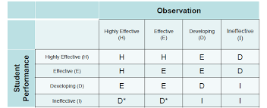
APPR…

Slide 26
School Messenger…
If you have a new phone number you’d like called by School Messenger (or you are a new employee) for up-dates/school closings – please see Gail Kiser (gkiser@southlewis.org)

Slide 27
HAVE A GREAT YEAR…
There continues to be great change in education, which has caused confusion, frustration, and uncertainty.
Change is also an opportunity to re-think, grow, and improve.

Slide 28
Moment to reflect…
Our #1 priority is children!
We are in this together and you will not be alone!
If you have questions or want to talk, please do!
We have come a long way, and we are showing success!
Hard work is required, but don’t overburden yourself!
We couldn’t ask to be in a better district!

Slide 29
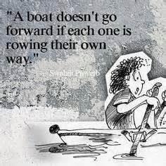
Have a great year!

